Slide 1
PHYS 1901
Exploration Indigenous Culture
Zesan Rahim - 101310293

Slide 2
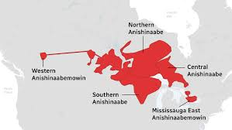
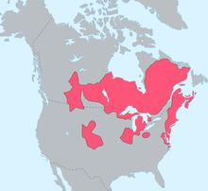
Main Focus
Algonquin and Anishinaabe Peoples of Canada

Slide 3
Indigenous Star Stories
Ojiig and Pleiades
Ojiig represented by Big Dipper
Tells the story of a brave fisher who brings warmth to the earth during the time of endless winter.
The tale explains “Ojiig climbs into the sky and tears a hole to release warm weather”
With the constellation changing it would mark the arrival of spring
Anishinaabe:
As we orbit around the sun, the change in the big dippers change in position also served as a practical seasonal guide for the algonquin people
Pleiades is a star-cluster
Associated with storytelling and spiritual renewal appearing mostly in the winter
Tale emphasizes kindness and care

Slide 4
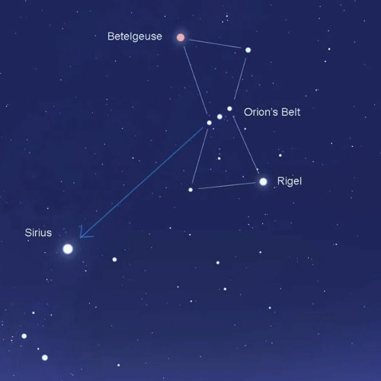
Navigational Techniques
- Famous star Polaris referred to as the North Star served as a reference for navigation
- The star guided canoes across lakes and rivers during trade and hunting trips
Anishinaabe:
- Orion's Belt were key constellations for tracking seasonal migrations
- Pleiades helped align travel with natural patterns like animal migration and seasonal shifts
Orion's Belt provided a reliable reference point for direction, especially during long winter nights

Slide 5
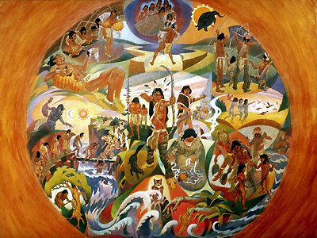
Ceremonial and Spiritual Importance
-The milky way was seen as the path of souls, guiding the spirit of the deceased to the afterlife
-Developed deep respect for ancestors and their spirits creating a connection between the living and the dead
-Reflects the Algonquin peoples understand that death is a transition rather than an end
Anishinaabe:
- The stars were integrated into sweat lodge ceremonies, representing the unity of the physic and spiritual worlds
- Stars symbolize guidance and balance, refincorcing Anishinaabe cosmology, where the celestial and earthly realms are inter connected

Slide 6
Citations
Algonquins of Greater Golden Lake First Nation. (n.d.). Culture and tradition. Retrieved October 14, 2024, from https://algonquinsofgreatergoldenlakefirstnation.ca/culture/#:~:text=Indigenous%20peoples'%20spiritual%20practices%20are,anything%20that%20is%20life%20sustaining
CBC News. (n.d.). Anishinaabemowin: Original voices. CBC News Interactive. Retrieved October 14, 2024, from https://www.cbc.ca/newsinteractives/original-voices/anishinaabemowin
Ojibwe-Dakota-in-MN. (n.d.). How Fisher went to the Skyland: A traditional Ojibwe story. Retrieved October 14, 2024, from http://www.ojibwe-dakota-in-mn.com/uploads/5/2/5/8/52587125/how_fisher_went_to_the_skyland.pdf
Revolving Sky. (n.d.). Star stories from Indigenous cultures. Retrieved October 14, 2024, from https://revolvingsky.com/star-stories.html
Quora. (n.d.). How is Polaris used to navigate? Retrieved October 14, 2024, from https://www.quora.com/How-is-Polaris-used-to-navigate#:~:text=Polaris%20is%20the%20end%20of,current%20latitude%20above%20the%20horizon
Wikipedia contributors. (n.d.). Algonquian peoples. Wikipedia. Retrieved October 14, 2024, from https://en.wikipedia.org/wiki/Algonquian_peoples
ZhaawanArt. (n.d.). Ojibwe star map and Indigenous star stories (Part 9). Retrieved October 14, 2024, from https://www.zhaawanart.com/post/star-stories-part-9-ojibwe-star-map
MLPP Pressbooks. (n.d.). Anishinaabe teachings and philosophy. In Exploring worldviews and Indigenous teachings. Retrieved October 14, 2024, from https://mlpp.pressbooks.pub/evcphil070/chapter/anishinaabe/#:~:text=Mother%20Earth%20is%20considered%20both,naming%20children%2C%20and%20much%20more
Smith, D. G. (2011, December 4). Religion of Aboriginal people. In Z. Parrott & M. Filice (Eds.), The Canadian Encyclopedia. https://www.thecanadianencyclopedia.ca/en/article/religion-of-aboriginal-people

